Slide 1
Paying by PayPal
Supporting the PTA by using the Friends and Family payment option on PayPal
Parent Teachers Association (PTA)
PS 115Q
2021-22 School Year

Slide 2
Helping the PTA Avoid PayPal Fees
This presentation will walk you through the steps for helping the PTA and families avoid PayPal fees
Avoiding PayPal fees helps the PTA by ensuring that we receive the full value of the payment so that it can be allocated to our programs

Slide 3
Log on to your PayPal Account
Press the Send button

Slide 4
On the Send Money Screen
Enter the PTA email address
ps115qpta@gmail.com

Slide 5
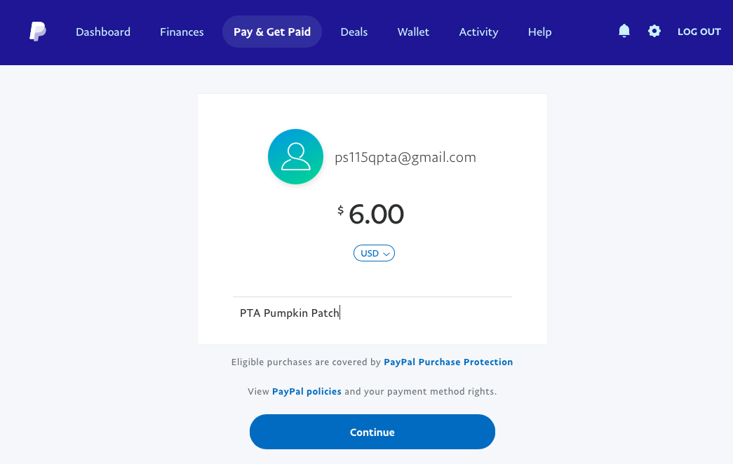
Enter the amount of the payment
And note why you are sending funds and press Continue

Slide 6
Change why you are sending funds
Press the Change button to make the edit

Slide 7
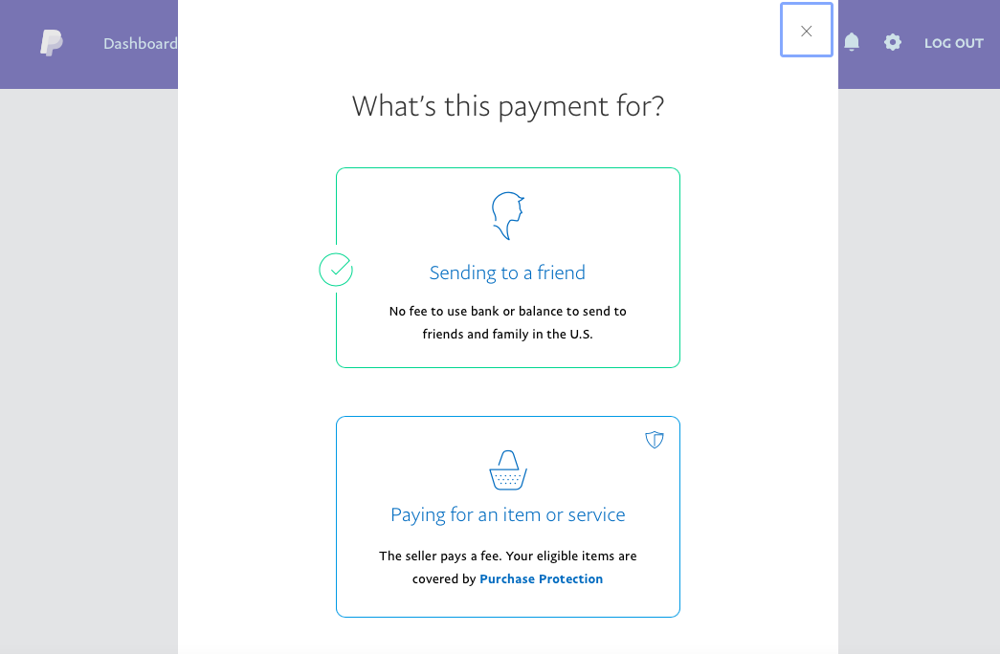
Change the default to Sending to a Friend

Slide 8
Make sure the change has been made

Slide 9
Press send Payment Now

Slide 10
Thank You for your support!

